Slide 1
Introduction to Programming
Lecture 4

Slide 2
Agenda
Functions (Part 1):
Why functions?
How to declare and use functions?
Types of functions.
Functions called from main.
Function Overloading.
Function calling another function.

Slide 3
Functions (Part 1)
A function is a collection of statements that performs a specific task.

Slide 4
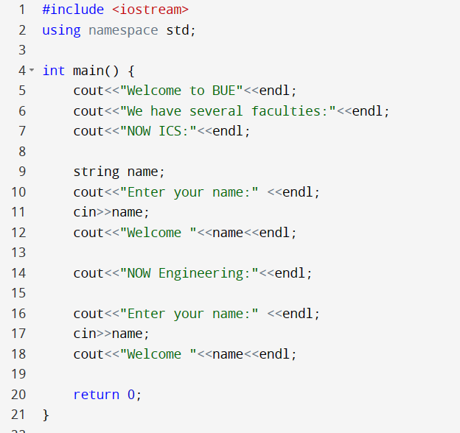

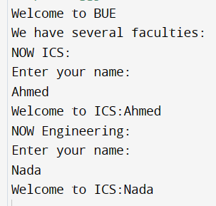


Functions
Imagine that every while I need to take the name of a student and print him a Greeting message, in the middle of doing other tasks in the program.
Repeated code

Slide 5
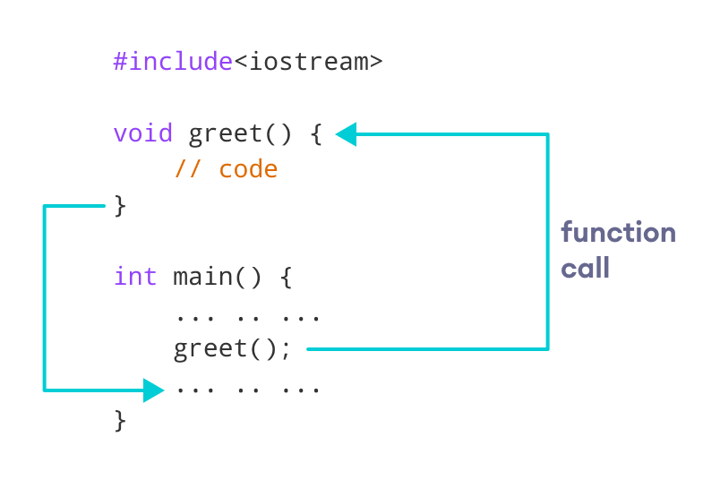

Functions

Slide 6
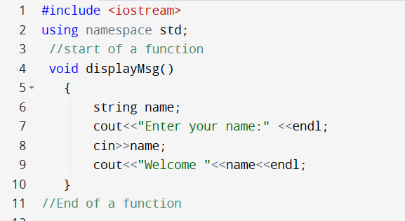
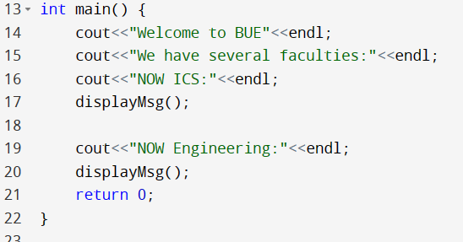

Functions
Imagine that every while I need to take the name of a student and print him a Greeting message, in the middle of doing other tasks in the program.
Calling a Function

Slide 7
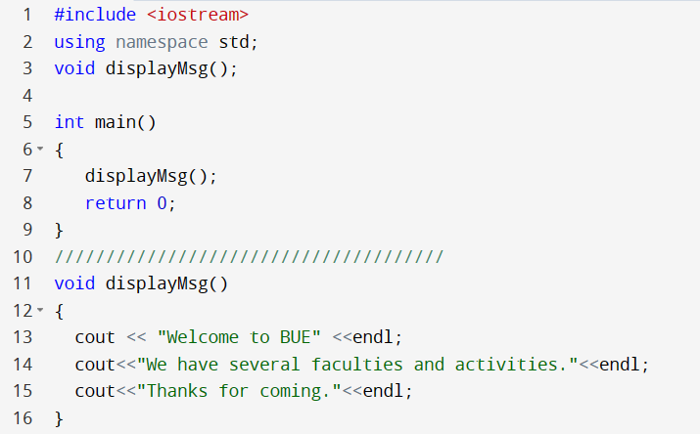
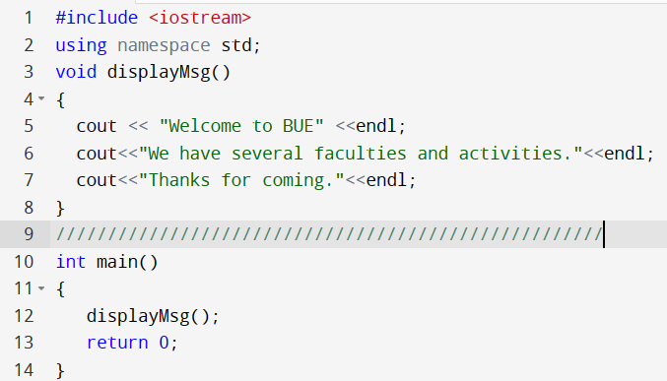




Function declaration
Function code after main
Function declaration
Or the whole function before main

Slide 8


Why Functions?
Functions allow the same piece of code to run multiple times.
Functions break long programs up into smaller components.
Functions can be shared and used by other programmers.
Dividing a complex problem into smaller chunks makes our program easy to understand and reusable.

Slide 9
Types of Functions
C++ functions
Built-in functions
(Library functions)
User-defined functions

Slide 10
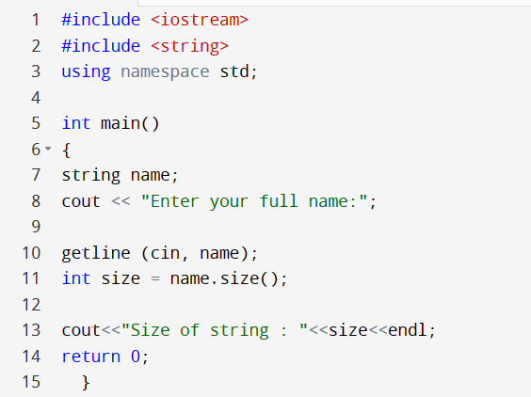




Built-in functions
Built-in functions are also called library functions.
These are the functions that are provided by C++ .
we need not write them ourselves.
We can directly use these functions in our code.
Predefined functions in C++
Can you think of other Predefined functions you took?

Slide 11
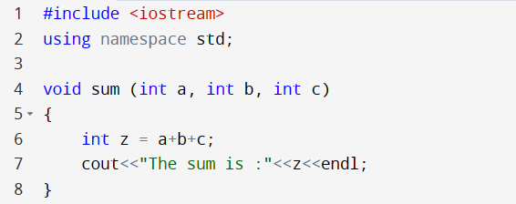
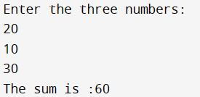
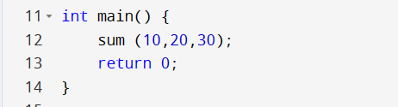
User-defined Functions
Function Call

Slide 12


Parameters and Return type
Main sends to function data through
Parameters
main
function
function send to main data through
Return type

Slide 13
User-defined Functions
Function name
Parameters
Return type
Function body
Actual Parameters (arguments)
Function Call

Slide 14
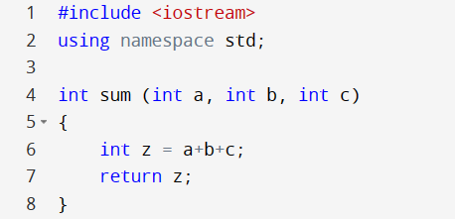
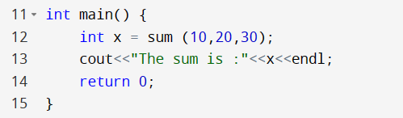
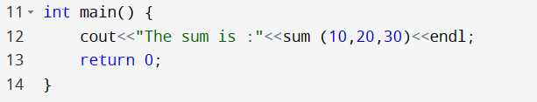








User-defined Functions
Different ways of coding a call to a function

Slide 15
User-defined Functions

Slide 16
Important parts of a function
Any function in C++ has 4 important parts:
Function Name: Identifier used to name a function.
Parameter List: Denoted by param1, param2,…param n. These are the arguments that are passed to the function when a function call is made. The parameter list is optional i.e. we can have functions that have no parameters.
Function body: A group of statements that carry out a specific task, these statements should be inside curly brackets { }.
Return type: It is the value that the functions return to the calling function after performing a specific task. The return type is void if the function doesn’t return anything.

Slide 17
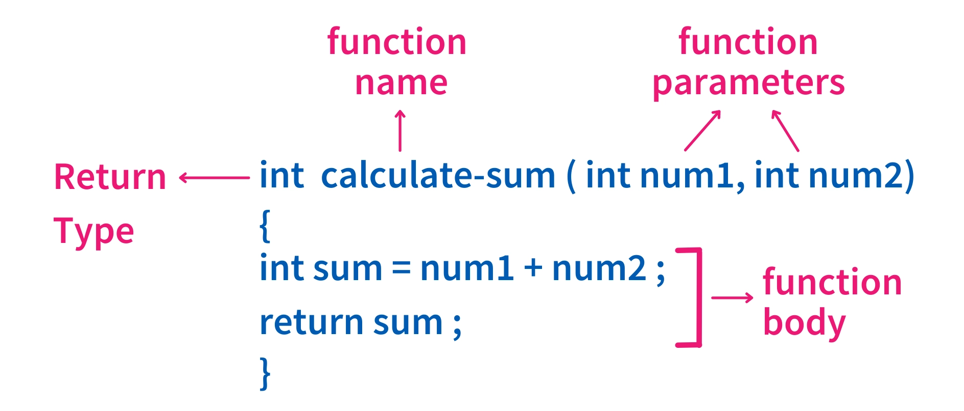
Function
return_type function_name( parameter list )
{
//function body written here
}

Slide 18
Passing parameters
Passing parameters
By Value
By Reference
Later in Functions part (2)

Slide 19
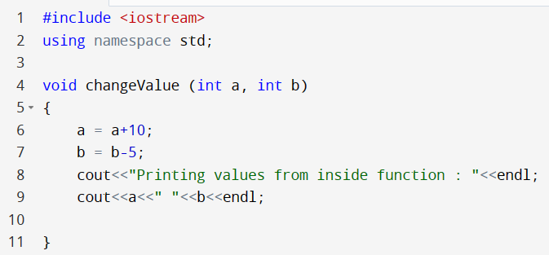
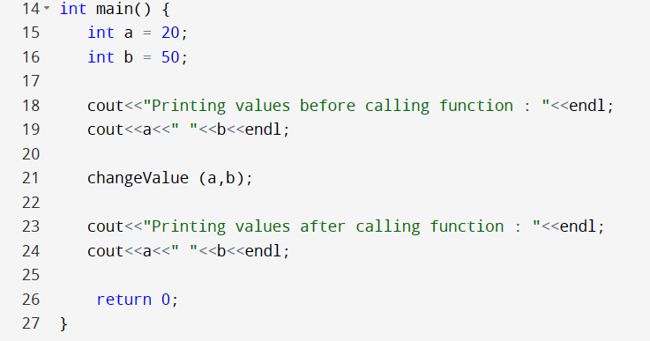
Passing parameters by value
Pass by Value (also known as pass-by-copy)

Slide 20

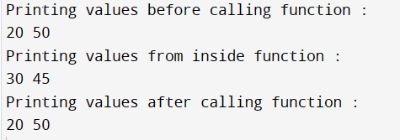
Passing parameters by value
Pass by Value (also known as pass-by-copy)
a
b
a
b
Passing parameters by coping the value
20
50
20
50
a
b
30
45

Slide 21
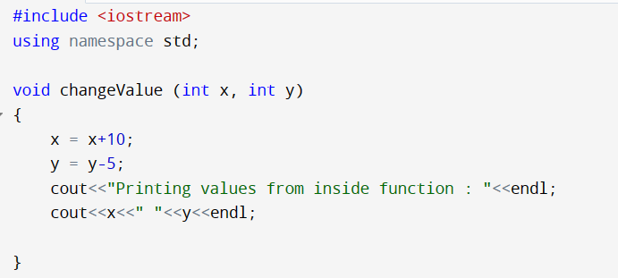



Passing parameters by value
Pass by Value (also known as pass-by-copy)
x
y
a
b
Passing parameters by coping the value
20
50
20
50
x
y
30
45
Whether you use the same variable names or not, no difference they are copies

Slide 22
Important notes
The type of the arguments passed while calling the function must match with the corresponding parameters defined in the function declaration.
Any program in C++ must contain a main function.
The processing of the program starts at the start of the main function “{”, and the processing of the program ends at the end of the main function “}”.
A program may contain more functions in addition to the main function.
A caller is a function that calls another function; a callee is a function that was called.

Slide 23

Visibility of Variables
A variable declared in the body of a function is a local variable that extends until the end of the function.
x and y are local variables to the function, they can not be seen by main.
a and b are local variables to main function, they can not be seen by any other function, except the copies sent through parameters

Slide 24

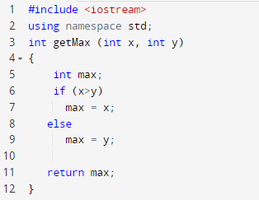
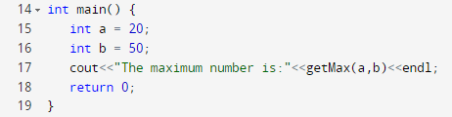
Example
Write a program having a function called getMax that receives two integer values from the main and returns the maximum number of them to be printed from the main.

Slide 25
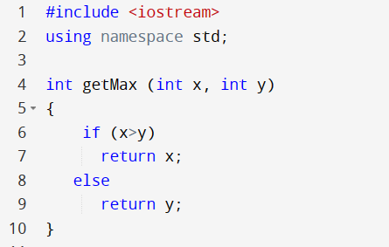

Example (another example)
Write a program having a function called getMax that receives two integer values from the main and returns the maximum number of them to be printed from the main.
If any return statement is executed, the whole function exits

Slide 26
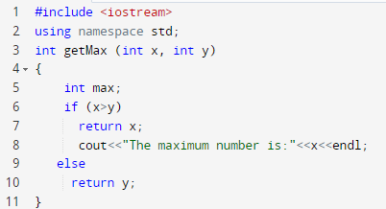



Example
Write a program having a function called getMax that receives two integer values from the main and returns the maximum number of them to be printed from the main.
If any return statement is executed, the whole function exits
xx
This statement is not reachable

Slide 27
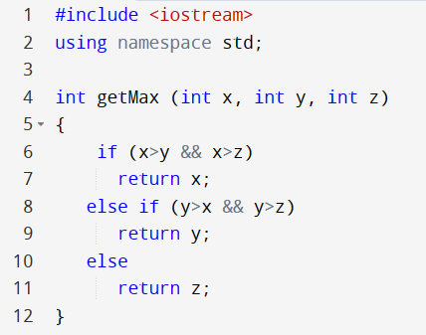
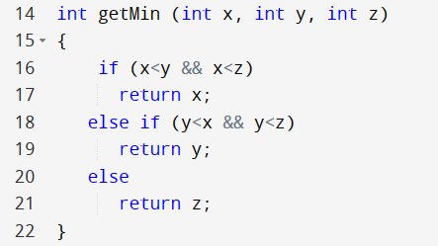
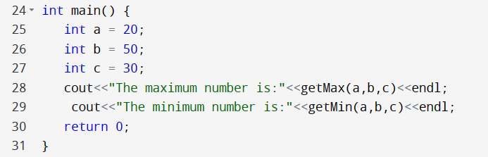


Calling more than one function from main
Write a program having two functions called getMax, getMin where each receives three distinct integer values from the main and returns the maximum number, and minimum number of them respectively to be printed from the main.

Slide 28
Function Overloading
Function overloading is a feature where two or more functions can have the same name but different parameters.
When a function name is overloaded with different jobs it is called Function Overloading.
A function cannot be overloaded with different return types in most programming languages.

Slide 29
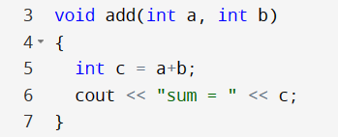
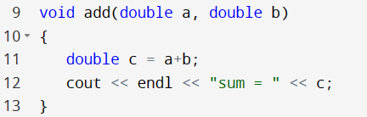
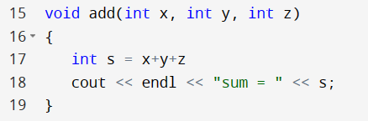
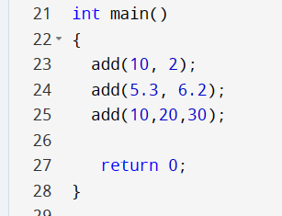



Function Overloading

Slide 30
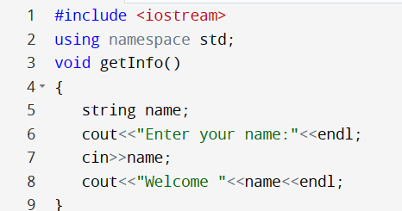
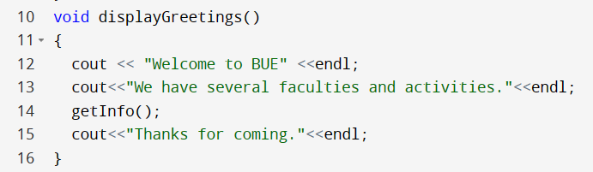
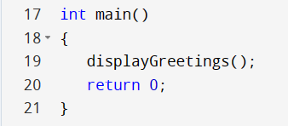
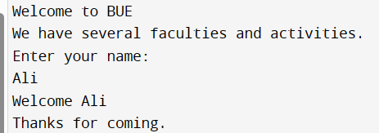




Function calling function
2
3
1
4
getInfo() should be written before displayGreetings()

Slide 31
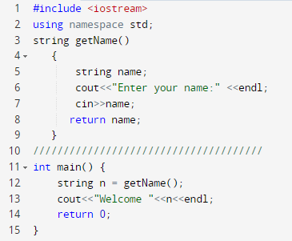




An Example returning a string

Slide 32
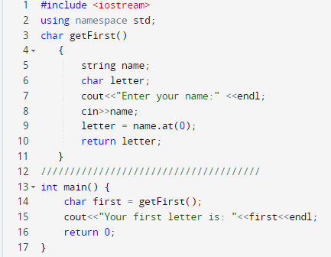

An Example returning a char

Slide 33

Thank You

